Slide 1
Lec02
GIS Database Concepts

Slide 2
GIS are driven by spatial data......
Two basic spatial(coordinate/geometric) data model exist
VECTOR: BASED ON GEOMETRY OF
Points
Lines
Polygons
RASTER : based on geometry of
Grid cells (images, bitmaps, DEM)

Slide 3
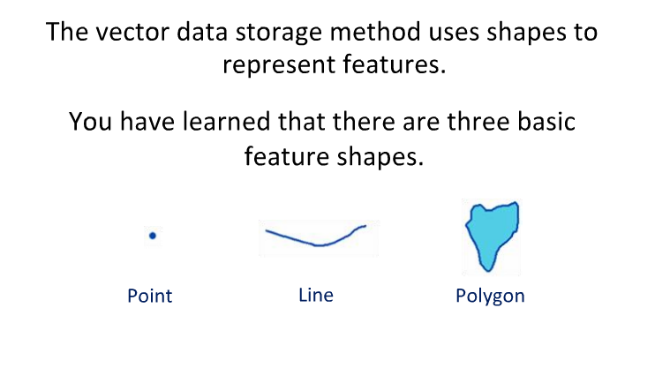
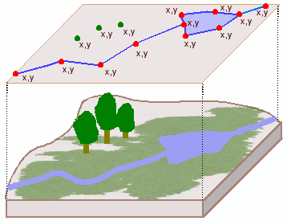
Vector data model
Discrete - Boundaries are well defined (x,y coordinates)

Slide 4
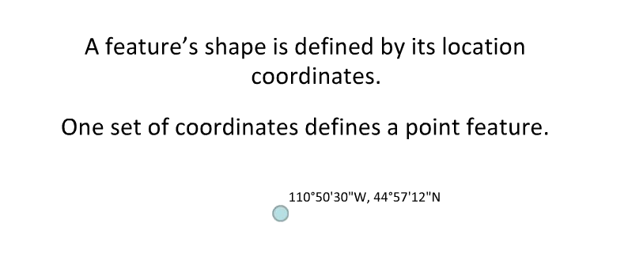
Point

Slide 5
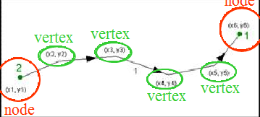
Line :
Line stars and end at nodes –here Line #1 goes from node #2 to #1
Vertices determines shape of line
Nodes and vertices are stored as coordinate pairs

Slide 6
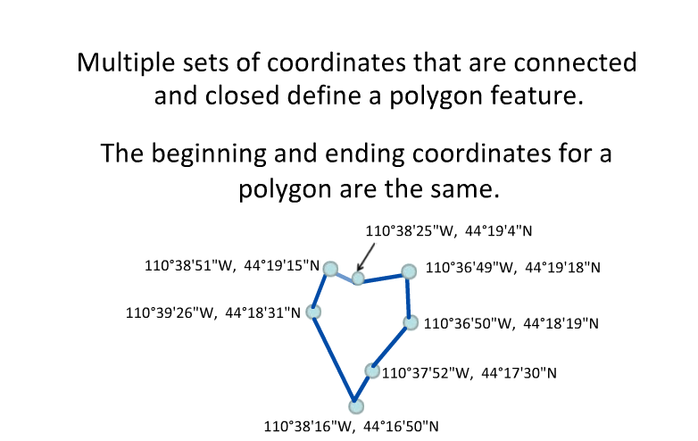
Polygon

Slide 7
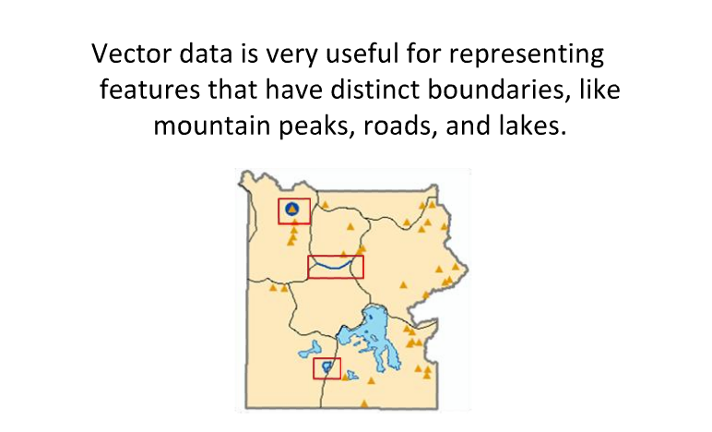

Slide 8
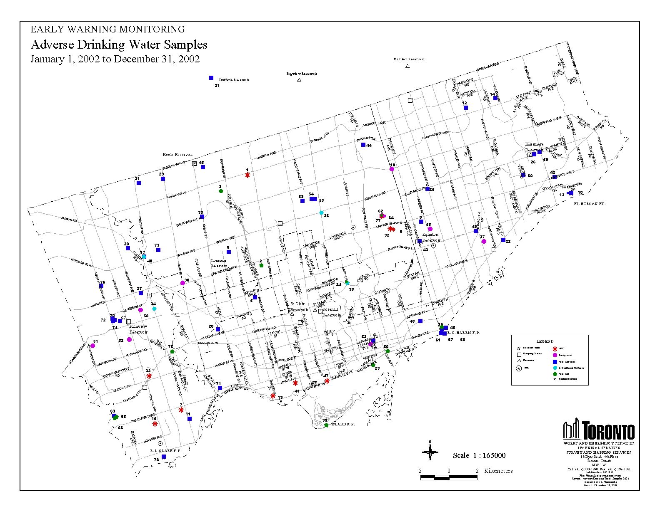
POINT REPRESENTATION
VECTOR DATA...
Nature of the feature: the reality suggests a point (it is not linear in nature, does not occupy an area):
  GPS Location
  hydrant
  rare plant location
  seep location…
Typically used for small scale representation.
Relative positioning and density of features is important.
Polygons can be represented as centroids --a special kind of point.

Slide 9
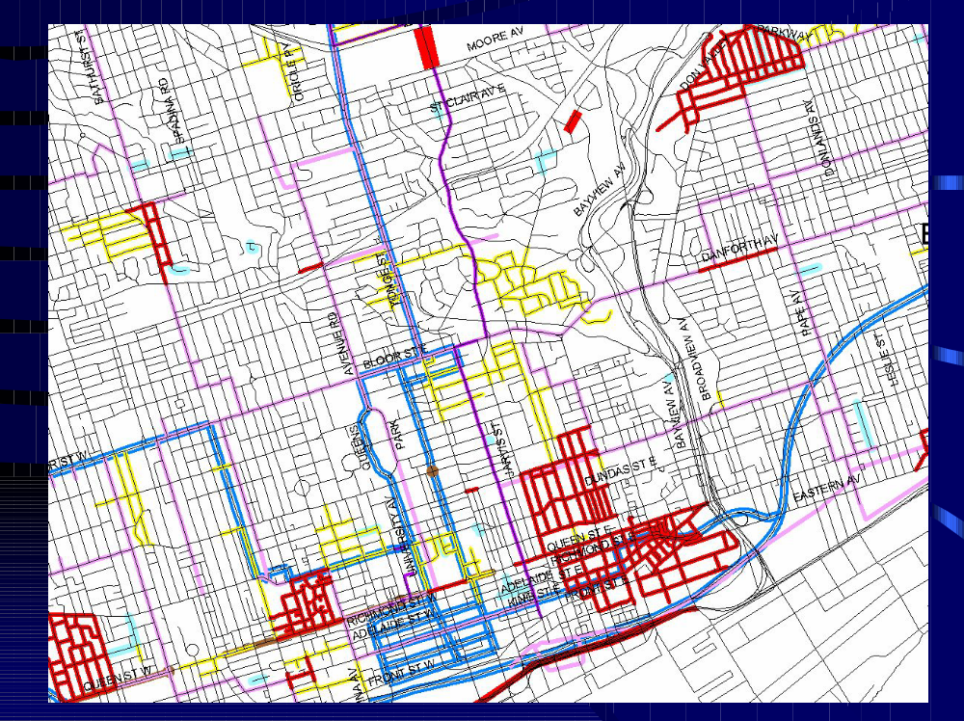
LINE REPRESENTATION
VECTOR DATA...
Nature of the feature, the reality is the feature is linear:
  GPS Path
  extent of rare plant community
  seep drainage …
Used at all scales, although may appear as a point at extreme small scales.
Networks are typically represented as single lines with events associated with segments of the network, e.g. Capital Works Projects associated with street segments.
Networks typically have traces performed to determine paths and routes.

Slide 10
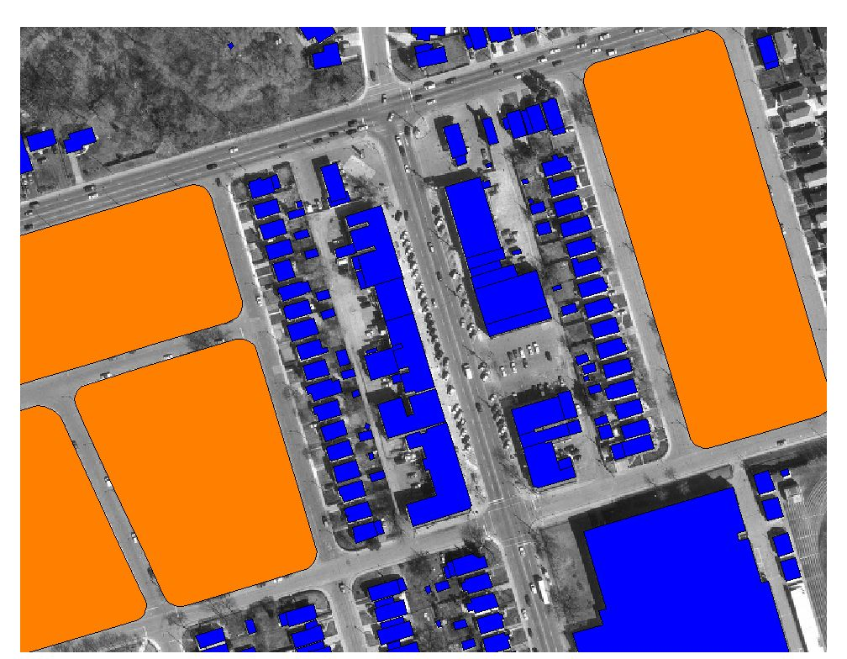
POLYGON REPRESENTATION
VECTOR DATA...
Nature of the feature, it occupies an area.
  GPS Location
  rare plant community
  area of seepage
Typically used at mid to large scales (dependent on the size of the feature/polygon).
Often the relative location of a second feature is important, e.g. hydrants (points) located in a road allowance (polygon).
Polygons can be represented as centroids --a special kind of point.

Slide 11
Major types (formats) of vector data available in ArcGIS
ArcView shape file (shp, dbf, shx, together)
ESRI Geodatabase (personal, ArcSDE)
ESRI Filegeodatabase (New for 9.2 and above)
ArcInfo Coverage
CAD files (AutoCAD dWG, DXF, MicroStation DGN)
Street map files
Spatial Database Engine (SDE) data
ASC11 point coordinate data
Linear measure (route) data

Slide 12


ArcView shapefiles
Preferred vector format in ArcView
Display quickly
Fully editable (coordinate and tabular) in ArcView
Simple in structure
Data sets are either point or line or polygon
ESRI Geodatabase
Based on shapefile data model
Multiple data sets stored in a relational database file
Stored in MS Access database or higher-end database
Separate points, line, and polygon data sets are stored within
the same Geodatabase

Slide 13
Characteristics of the vector data model:
+ Features are positioned accurately
+ Shape of features can be represented correctly
+ Features are represented discretely (no fuzzy boundaries)
- Not good for representing spatially continues phenomena
ex: precipitation measurement, forest cover, animal
home range
- Potential complex data structure (specially for polygons
can lead to long processing time for analytical operations)

Slide 14
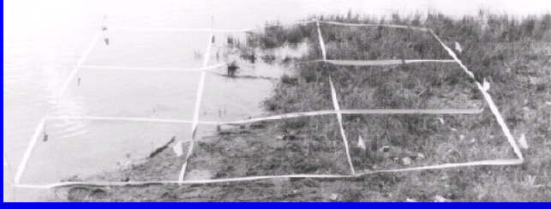
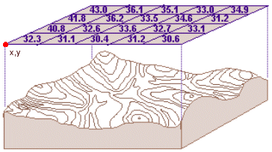
Raster Data Model
The world is composed of cells/pixels arranged in a grid
Each cell/pixel is assigned a numeric value
  Integer – (no decimal)
  Floating-point (decimal)
  (However data may be represented by codes)
The size of the cell/pixel
determines the resolution
Every location given an object

Slide 15


DATA MODEL OF RASTER AND VECTOR
REAL WORLD
1 2 3 4 5 6 7 8 9 10
GRID RASTER
VECTOR

Slide 16
Lake
Pond
River
Reality - Hydrography
Lake
Pond
River
Reality overlaid with a grid
0
0
0
0
0
0
0
0
0
1
1
0
0
0
0
0
0
0
0
1
1
1
1
1
0
0
0
0
0
0
0
2
1
1
1
0
0 = No Water Feature
1 = Water Body
2 = River
0
1
1
2
0
0
2
0
0
0
0
0
0
0
0
0
2
2
0
0
0
0
0
0
0
0
2
0
0
0
0
0
0
0
0
Resulting raster
Creating a Raster

Slide 17
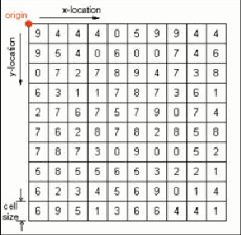
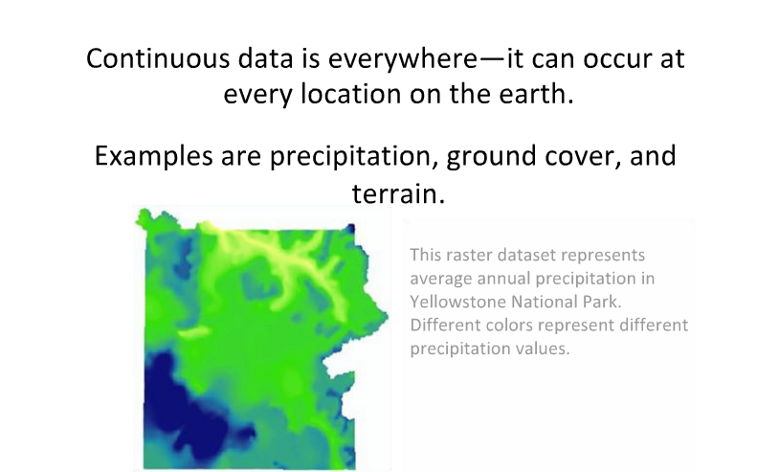
Raster Data Model
Origin is set explicitly
Cell size is always known
Cell references (row/column locations) are known
Cell values are referenced to row/column location
Values represent numerical phenomena or index codes for
non –numerical phenomena

Slide 18
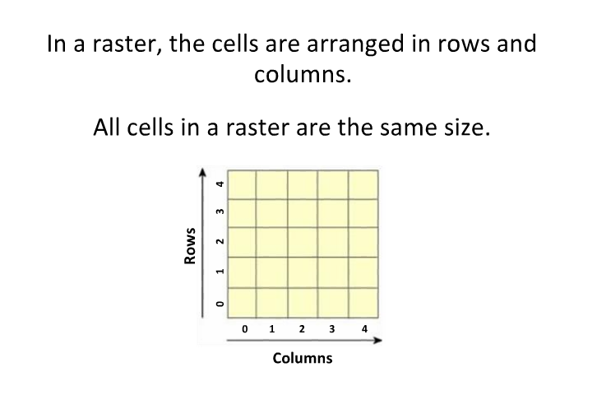
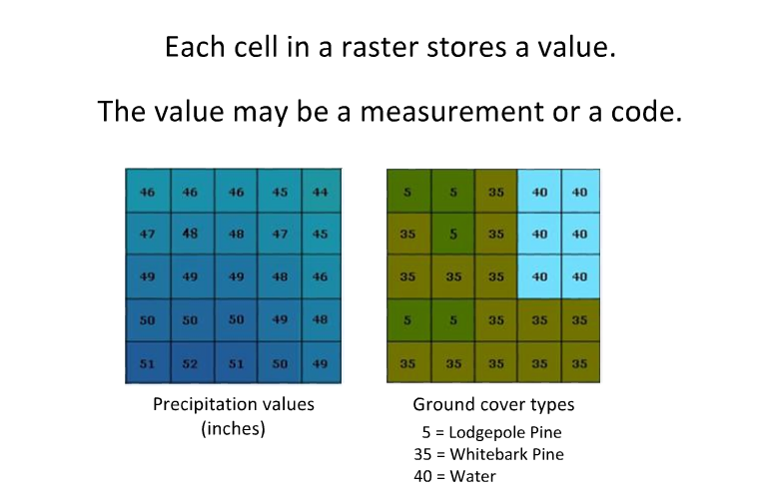

Slide 19
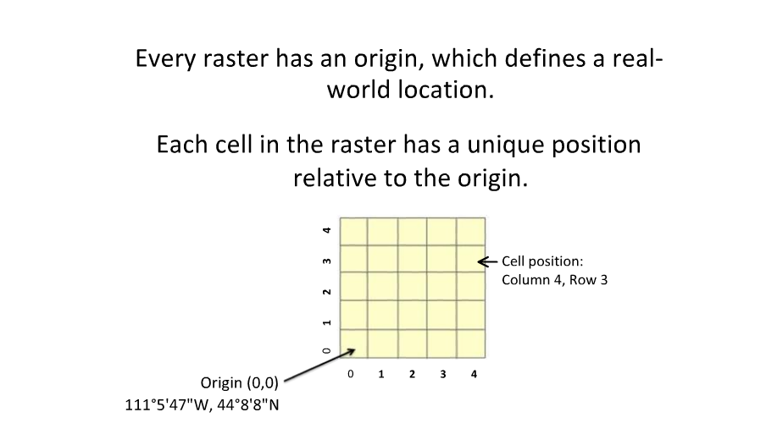
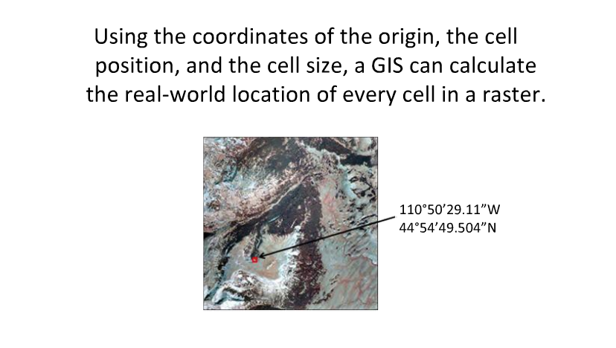

Slide 20
Characteristics of the raster data model
Rectangular grid of square cells
- Shape of discrete polygonal features generalized by cells
+ Continuous (surface) data represented easily
+ Simple data structure
Raster data are good at representing continues phenomena
eg..
- Wind speed
- Elevation, slope, aspect
- Chemical concentration
- Likelihood of existence of a certain species
- Electromagnetic reflectance (Photography or Satellite imagery)

Slide 21
Types of Raster Data
Remotely Sensed Images
  Satellite
    Landsat (http://landsat.usgs.gov/)
    AVHRR (http://edc.usgs.gov/products/satellite/avhrr.html)
    SPOT (http://www.spot.com/)
  Digital Elevation Models (DEMs)
    U.S. Geologic Survey (USGS) DEMs
    LIDAR (light detection and ranging)
    Multibeam sonar (acoustics for capturing depth information)
  Digital Orthophotos

Slide 22
Types of Raster Data – Images
Digital Raster Graphics (DRGs)
  Scanned USGS topographic maps (http://topomaps.usgs.gov/drg/)
Graphic Image Files – historic aerial photos, scanned paper maps
  .tif (Tagged Image File Format)
  sid (LizardTech MrSID)
  .img (ERDAS Imagine)
  .jpg (Joint Photographic Experts Group).
Many packages work on RECTIFYING these images
  photograph’s scale is not constant across image

Slide 23
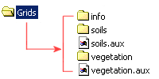
Raster Data Formats
  ESRI Grids
    Proprietary format
    Discrete – integer (whole number)
    Continuous – floating point (number with decimals)

Slide 24
Raster Resolution
RASTER DATA...
Expressed as the ground pixel measured in cm (aerial) or m (satellite).
  15 cm resolution or ground pixel means that each pixel in the image corresponds to 15cm on the ground.

Slide 25
Raster Resolution
RASTER DATA...
Resolution:
Refers to how accurately the location and shape of map feature can be depicted (presented) at a given scale
Large Scale Maps have better resolution because the reduction is less
As Scale becomes smaller, more and more features become too small to display

Slide 26
Raster Resolution
RASTER DATA...
Accuracy:
Accuracy of a raster image relates to positional location of a pixel relative to its true position.
Accuracy is a combination of resolution, map scale

Slide 27
Raster Resolution
RASTER DATA...
Scale
The image scale or map scale as it is sometime called refers to the relative difference in size or distance between the image and the features represented on the ground.
This difference is written as a ratio of image distance over ground distance.
For example, a scale of 1:100,000 (one to one hundred thousand) means 1 centimeter on the map equals 100,000 centimeters (1km) on the ground. The following is a list of scales and equivalent ground distances for three distances measured on an image.

Slide 28
Raster Resolution
RASTER DATA...
Image scale | 1 mm on image | 3 mm on image | 5 mm on image
1:10,000 | 10 m | 30 m | 500 m
1:40,000 | 40 m | 120 m | 2,000 m
1:100,000 | 100 m | 300 m | 5,000 m
1:500,000 | 500 m | 1,500 m | 25,000 m

Slide 29
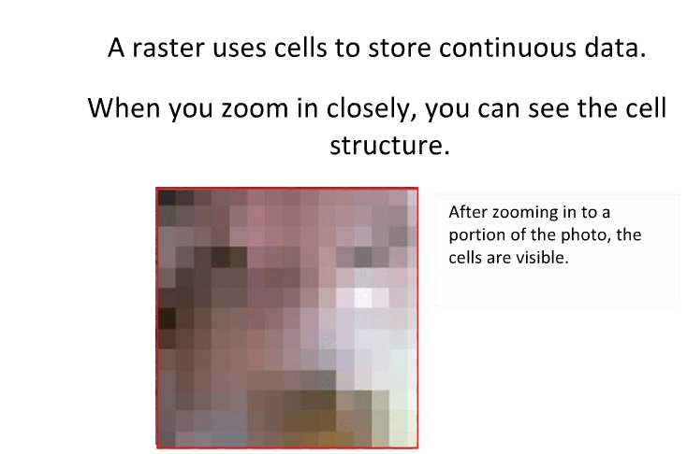
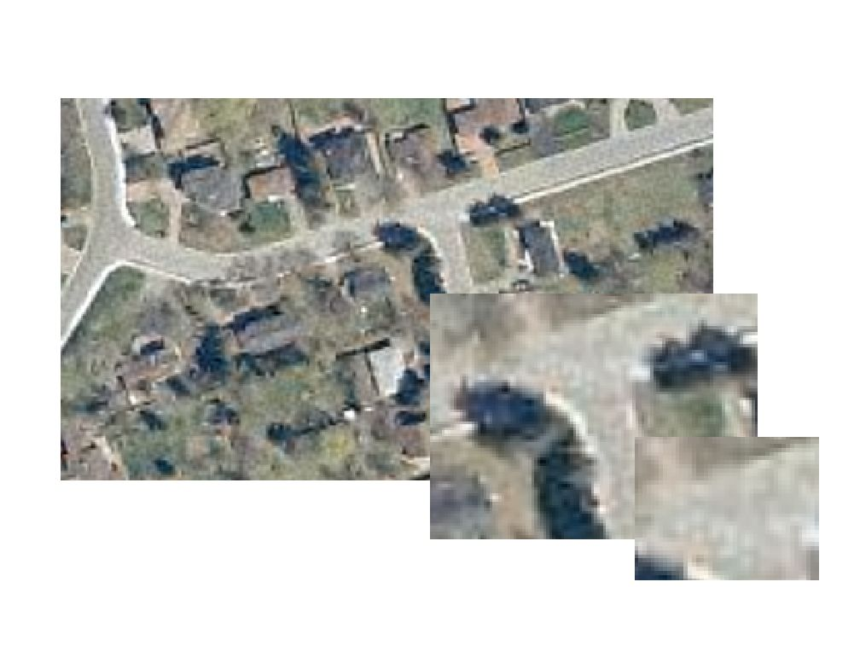
Grid of cells called pixels
Two dimensional
Each pixel has a discrete value, I.e. grey scale value

Slide 30
Raster and Vector Summary
Vectors have advantage of accuracy but not good with continuous fields
Vectors were used first - digitizing
Raster not good with lines or points but good with continuous coverage areas.
Raster has the mixed pixel problem.

Slide 31
Vector Advantages
Requires less disk storage space
Topological relationships are readily maintained
Graphical output more closely resembles hand-drawn maps
Preferred for network analysis
Vector Disadvantages
More complex data structure
Not as compatible with remotely sensed data
Software and hardware are often more expensive
Some spatial analysis procedures may be more difficult
Overlaying multiple vector maps is often time consuming

Slide 32
ATTRIBUTE DATA
GIS DATABASE CONCEPTS...
Organizing Attribute Data
a. Flat Files
b. Hierarchical Files
c. Relational files – Very Important
Representing Relationship
Topological Relationship – very Important

Slide 33
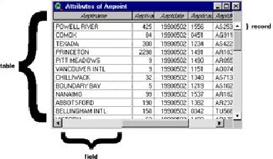
Attribute data are stored in database tables
Tables are composed of:
1. Fields
2. Records

Slide 34
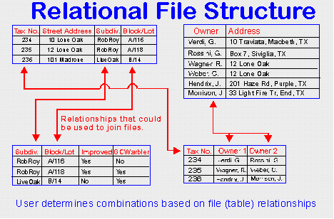
Relational files ......
Connect different files or tables (relations) without using internal pointers or keys.
Instead a common link of data is used to join or associate records
A "matrices of tables" is used to store the information
The tables have a common link they may be combined by the user to form
new inquires and data output

Slide 35
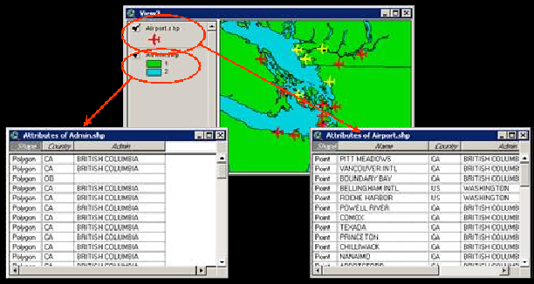
ArcGIS uses tabular data formats from dbase, ASC11 text, and INFO files
Tables are stored on the disk as
.dbf files
.txt files or
binary files in INFO directories
Each vector data source has an attribute table

Slide 36
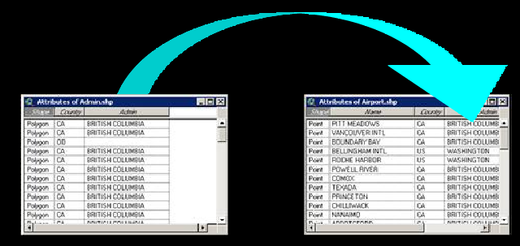
Tables can be linked and joined (“Related”) by use of common values in fields

Slide 37
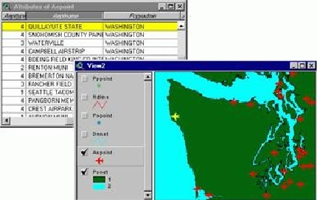
Relationship between map and tabular data....
One to one between feature and records
When selection is made, both the record and the feature are selected

Slide 38
Different types of data that may have attribute tables in ArcGIS
Vector
Point attribute
Polygon attribute
Line attribute
Node attribute
Text attribute
Route and event
CAD attribute
Raster
Value attribute table

